Slide 1


WASTE
RMC
MANAGEMENT
SYSTEM
PResenTATiOn bY MusTAfA

Slide 2

CONTENT
INTRODUCTION
01
05
REDUCE
OUR SYSTEM
02
06 REUSE
SOURCE Of GARBAGE
03
07 RECYCLE
PROCESS MANAGEMENT
04

Slide 3

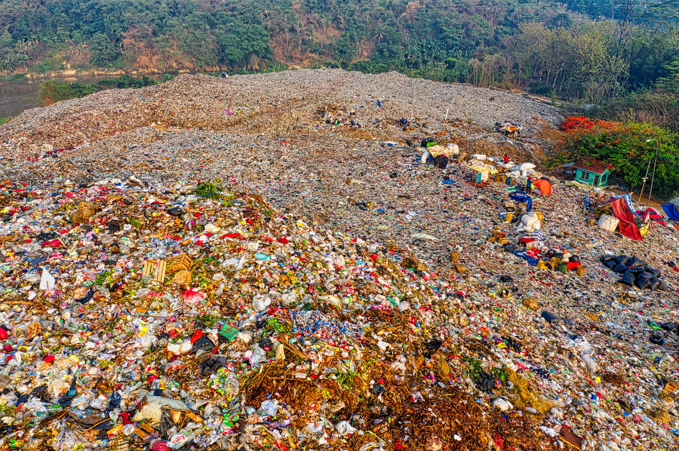
INTRODUCTION
A heAlThY enviROnmenT is An enviROnmenT ThAT is fRee fROm POlluTiOn And gARbAge, One Of The fAcTORs ThAT cAuses A POlluTed enviROnmenT is gARbAge, gARbAge hAs becOme One Of The mOsT dAngeROus fAcTORs fOR heAlTh And life
01

Slide 4


OUR SYSTEM
mAnAgAmenT
TO incReAse Public AwAReness in mAinTAining cleAnliness And PReseRving The enviROnmenT,
mOniTORing
The gOAl is TO mAke The wAsTe mORe PROTecTed
02

Slide 5


SOURCE Of GARBAGE
MARkeT TRAsh, COmmeRCiAl PlACes
fACTORY OR indusTRiAl wAsTe hOusehOld, OffiCe, insTiTuTiOnAl And YARd wAsTe
03

Slide 6


PROCESS
WASTE
ORGAniC
nOn ORGAniC
COmPOsT
ReCYCle
desTROYed
04

Slide 7
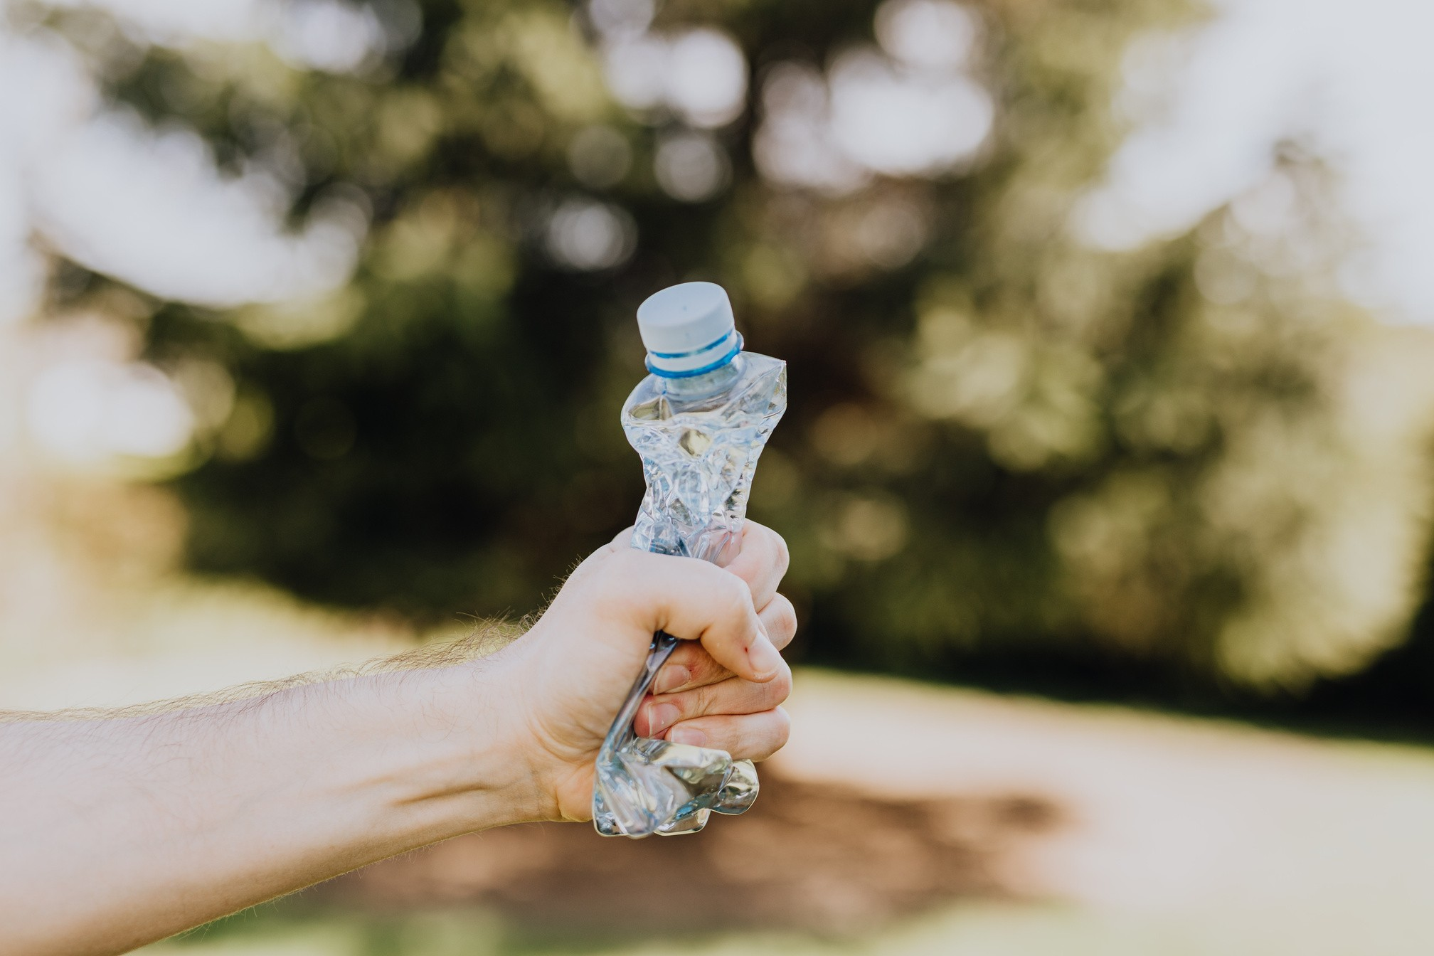
REDUCE
wheRe we hAve TO ReduCe The AmOunT Of wAsTe And sAve On The use Of GOOds ThAT hAve The POTenTiAl TO beCOme wAsTe
05

Slide 8

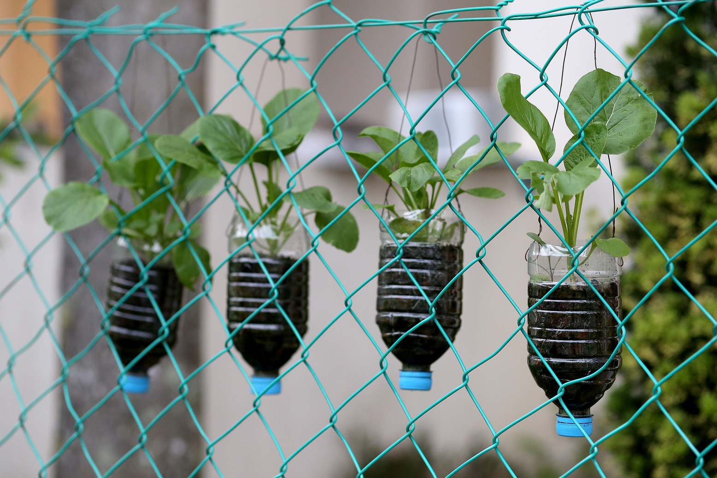
REUSE
Reuse iTems ThAT CAn sTill be used, dOn'T ThROw Them AwAY immediATelY, buT As muCh As POssible, Reuse Them OveR And OveR AGAin
06

Slide 9
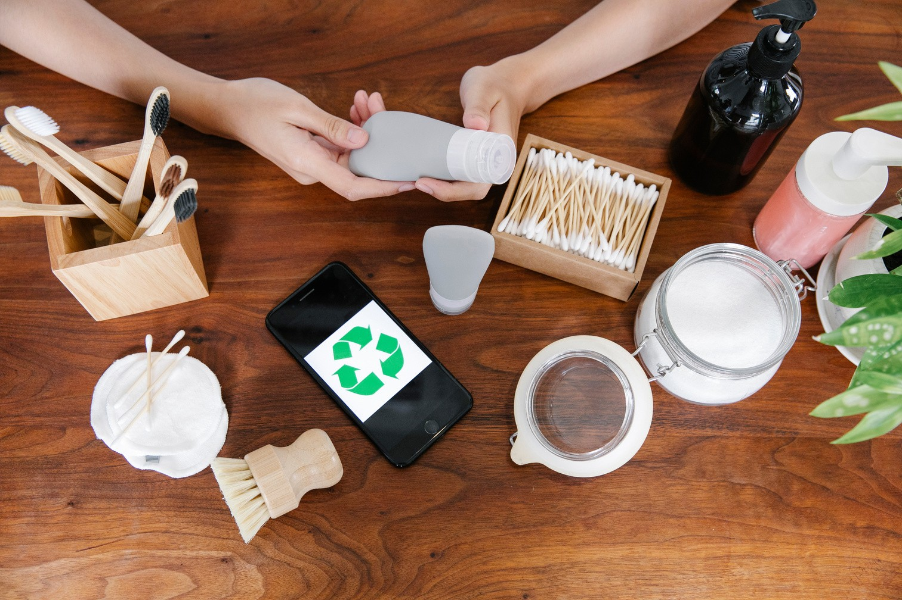
RECYCLE
ReCYClinG PAPeR wAsTe CAn mAke An exTRAORdinARY wORk even ThOuGh iT is mAde fROm wAsTe mATeRiAl
07

Slide 10
WAY 8C YSCfYt TNANC YOY

